Slide 1
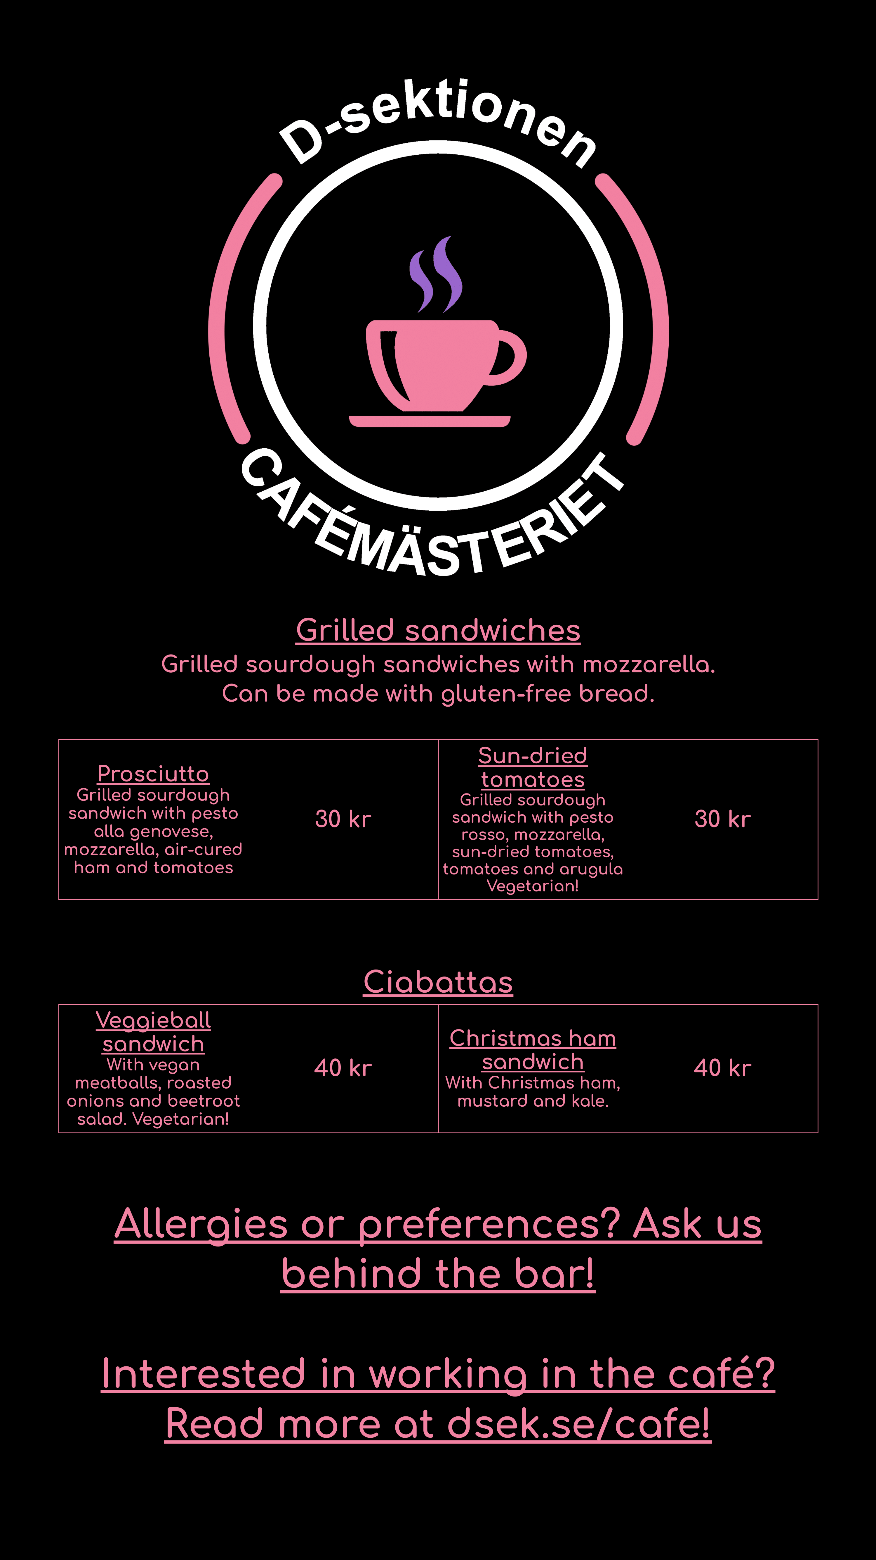









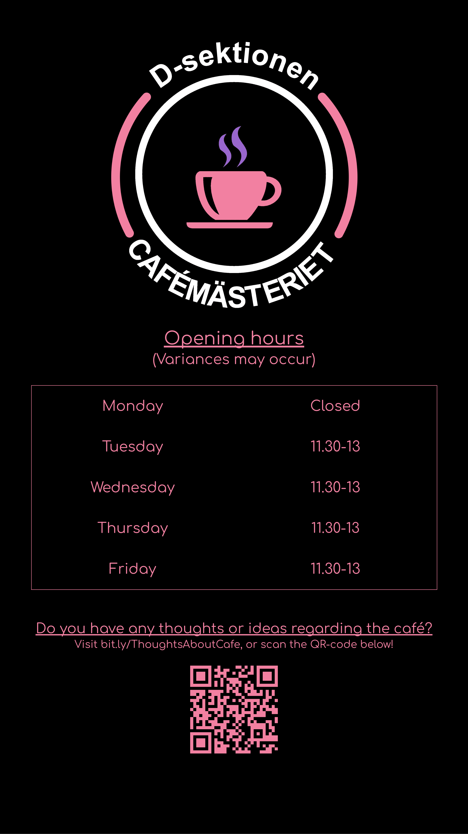

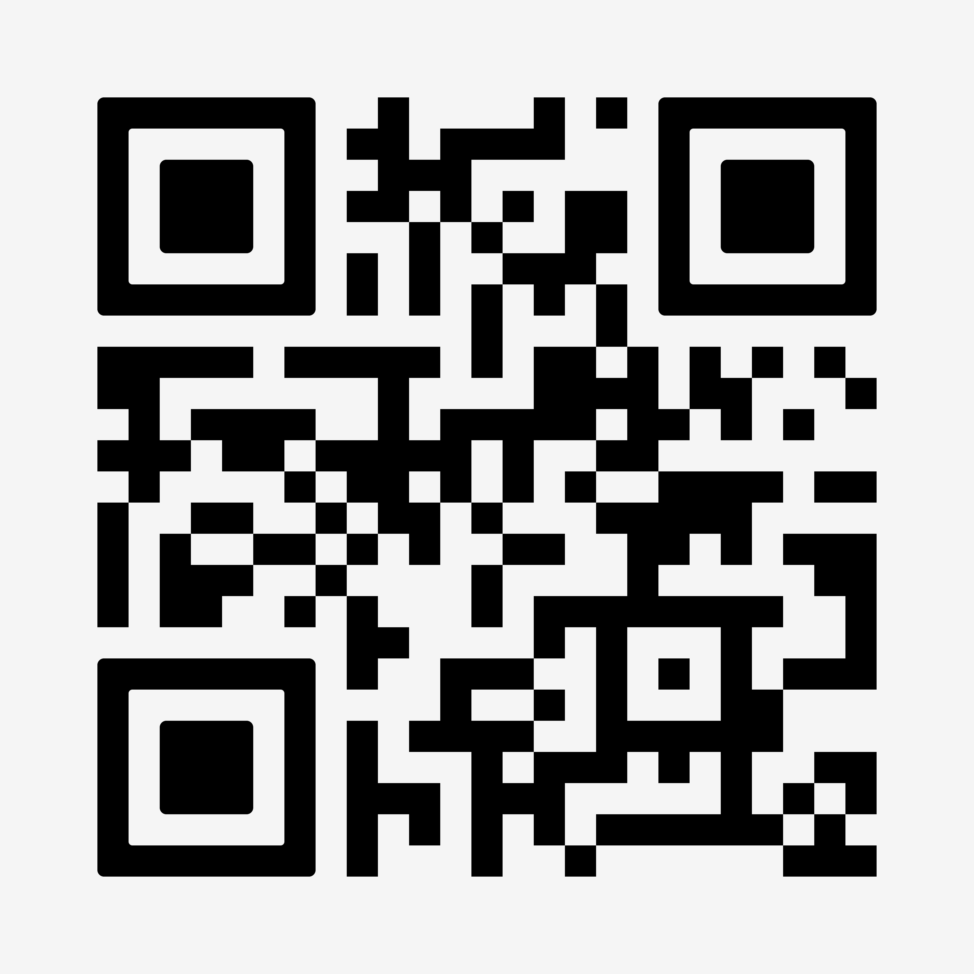
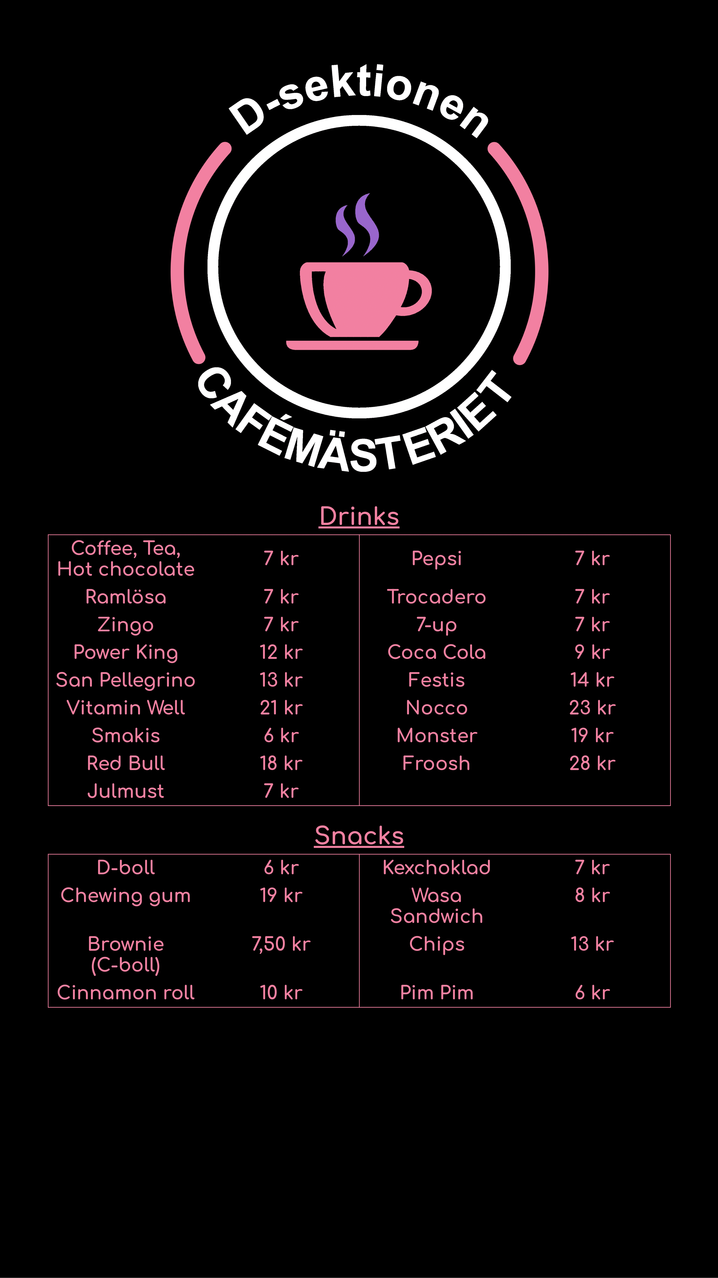
DRINKS
GRILLED SANDWICHES – 30 kr
OPENING HOURS
HOT DRINKS
ENERGY
Variances may occur
Grilled sourdough sandwiches with mozzarella. Can be made with gluten-free bread.
Coffee
Tea
Hot chocolate
7 kr
7 kr
7 kr
Power King
Redbull
Monster
Nocco
Vitamin Well
Froosh
12 kr
18 kr
19 kr
23 kr
21 kr
28 kr
SUN-DRIED
TOMATOES
Monday
Tuesday
Wednesday
Thursday
Friday
Closed
11.30– 13.00
11.30 – 13.00
11.30 – 13.00
11.30 – 13.00
PROSCIUTTO
Pesto alla Genovese
Mozzarella
Air-cured ham
Tomatoes
Pesto rosso
Mozzarella
Sun-dried tomatoes
Tomatoes
Arugula
SODAS
Pepsi
Zingo
7-up
Julmust
Trocadero
Coca Cola
San Pellegrino
7 kr
7 kr
7 kr
7 kr
7 kr
9 kr
13 kr
Vegetarian
SAFT (ish)
Smakis
Ramlösa
Festis
6 kr
7 kr
14 kr
CIABATTAS – 45 kr
VegoMacka
köttMacka
Do you have any thoughts or ideas regarding the café?
SNACKS
Vegetarian
Visit bit.ly/ThoughtsAboutCafe, or scan the QR code below!
D-boll
Brownie (C-boll)
Cinnamon roll
Chewing gum
Pim Pim
Kexchoklad
Wasa Sandwich
Chips
6 kr
7 kr
8 kr
13 kr
6 kr
7.50 kr
10 kr
19 kr
Allergies or preferences?
Ask us behind the bar!
Interested in working in the café?
Read more at dsek.se/cafe!

Slide 2

DRINKS
HOT DRINKS
ENERGY
Coffee
Tea
Hot chocolate
Power King
Redbull
Monster
Nocco
7 kr
7 kr
7 kr
12 kr
18 kr
21 kr
27 kr
SODAS
Pepsi
Zingo
7-up
Trocadero
Coca Cola
Pommac
Loka crush
10 kr
10 kr
10 kr
10 kr
12 kr
10 kr
10 kr
OTHER DRINKS
Smakis
Ramlösa
Festis
San Pellegrino
7 kr
10 kr
14 kr
18 kr
SNACKS
Kexchoklad
Wasa Sandwich
Chips
D-boll
Brownie (C-boll)
Dammsugare
Chewing gum
8 kr
10 kr
10 kr
19 kr
12 kr
12 kr
15 kr

Slide 3

GRILLED SANDWICHES – 35 kr
Grilled sourdough sandwiches with mozzarella. Can be made with gluten-free bread.
PROSCIUTTO
SUN-DRIED
TOMATOES
Pesto alla Genovese
Mozzarella
Air-cured ham
Tomatoes
Pesto rosso
Mozzarella
Sun-dried tomatoes
Tomatoes
Arugula
Vegetarian
CIABATTAS – 45 kr
VegoMacka
KöttMacka
Vegan
Allergies or preferences?
Ask us behind the bar!
Interested in working in the café?
Read more at dsek.se/cafe

Slide 4
STEKARLUNCH
Pesto alla Genovese
Mozzarella
Air-cured ham
Tomatoes
JAPCHAE - 40 KR
Korean sweet potato noodles with tofu, mushroom and spinach, flavored with soy sauce, sesame oil and gochujang
Allergies or preferences?
Ask us behind the bar!
Interested in working in the café?
Vegan
Read more at dsek.se/cafe

Slide 5
MATLÅDA
Pesto alla Genovese
Mozzarella
Air-cured ham
Tomatoes
CHILI SIN CARNE – 45 KR
Ingredienser:
Ris, Krossade tomater, kidney bönor, svarta bönor, röda linser, gullök, paprika, olivolja, grön chili, vitlök, kryddor (oregano, spiskummin, vitlökspulver, chilipulver, mononatriumglutamat, salt, peppar)
Allergies or preferences?
Ask us behind the bar!
Interested in working in the café?
Vegan
Read more at dsek.se/cafe

Slide 6
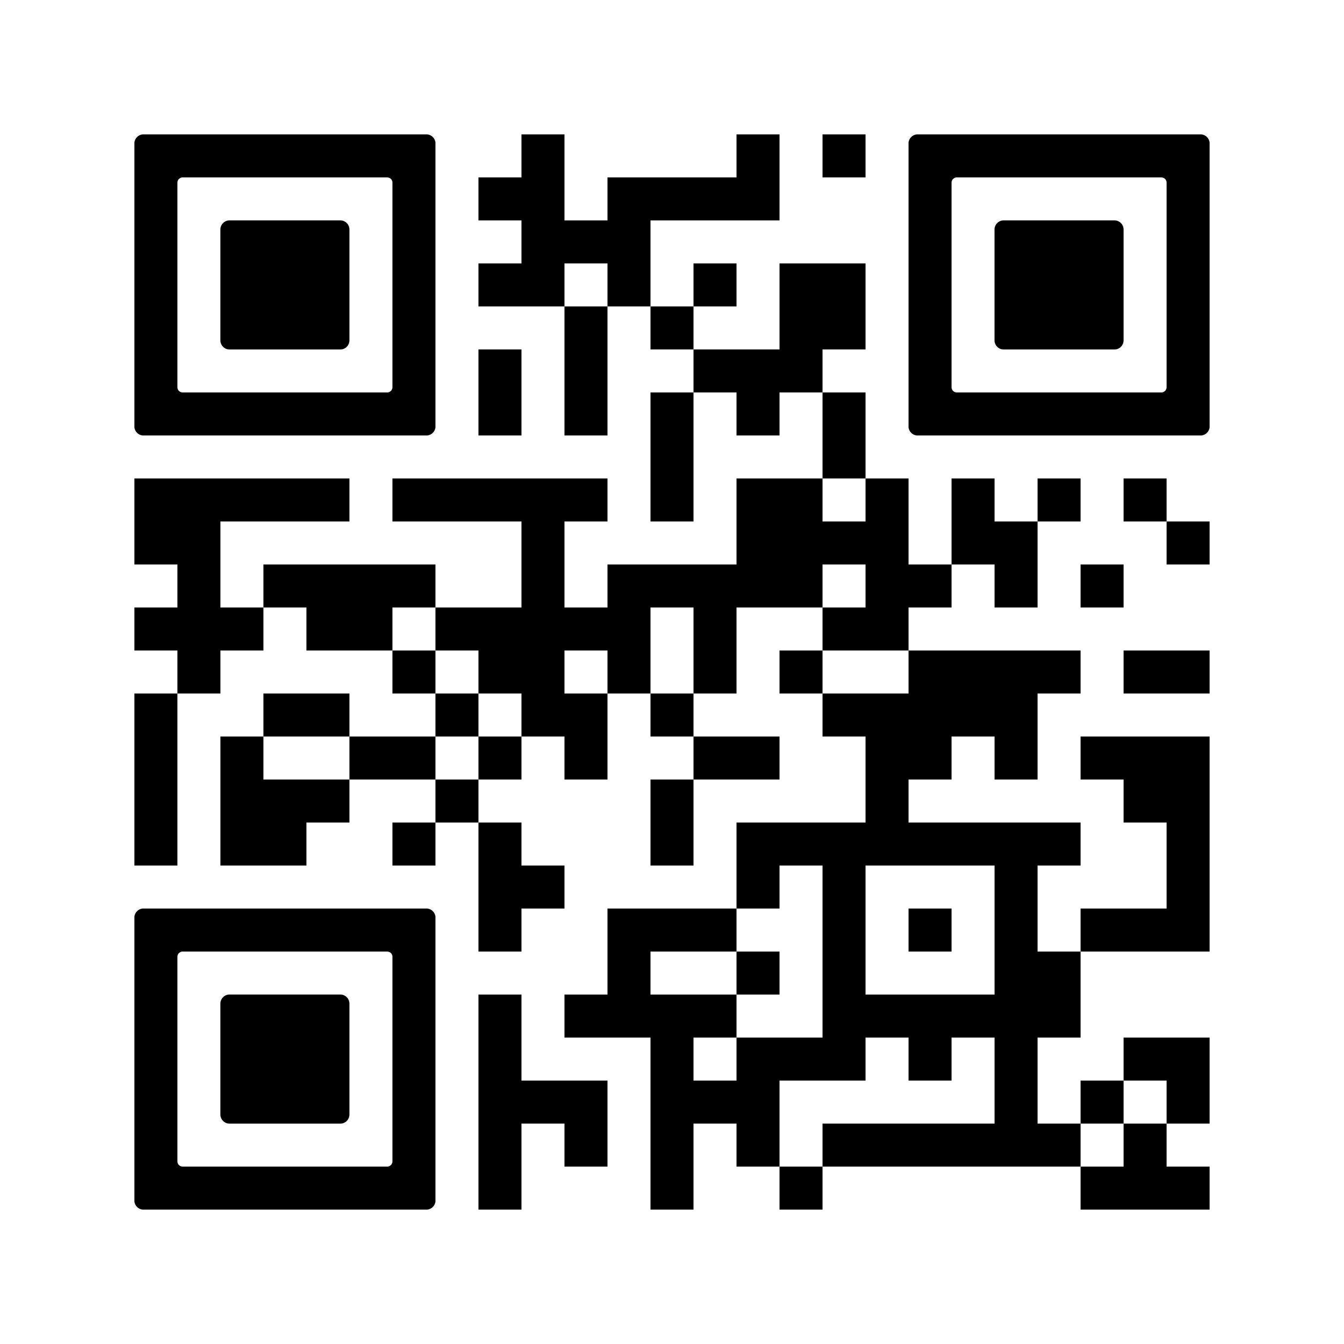
OPENING HOURS
Variances may occur
Monday
Tuesday
Wednesday
Thursday
Friday
11.30 – 13.00
11.30 – 13.00
11.30 - 13.00
11.30 – 13.00
11.30 – 13.00
BAKISARNA BAKAR
Kärleksmums – 15kr

Slide 7
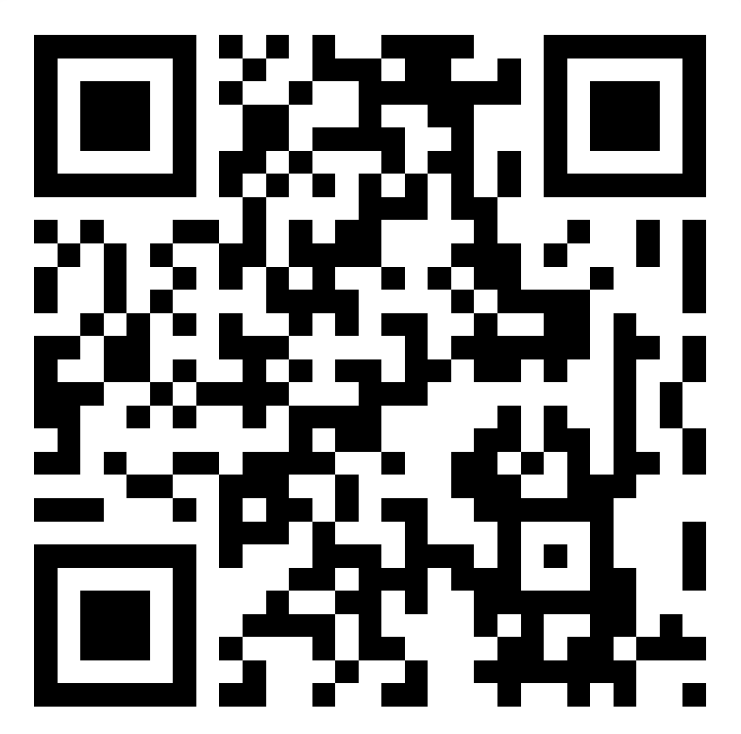
OPENING HOURS
Variances may occur
Monday
Tuesday
Wednesday
Thursday
Friday
Closed
11.30-13.00
11.30-13.00
11.30-13.00
11.30-13.00
Do you have any thoughts or ideas regarding the café?
Visit link.dsek.se/thoughtsaboutcafe, or scan the QR code below!

